Slide 1
Quantum Computing
Aviral Shrivastava

Slide 2
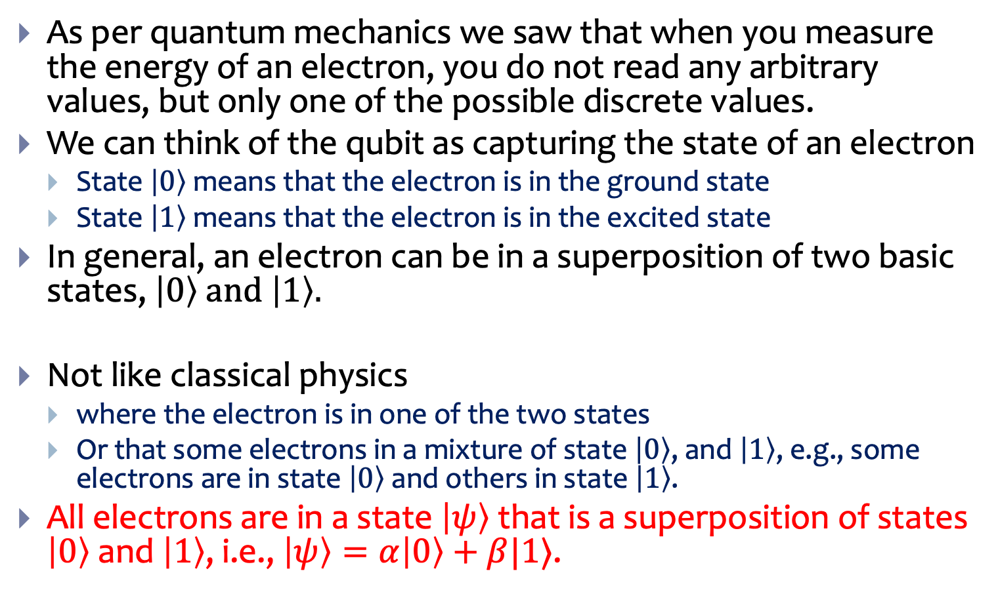


Qubit
As per quantum mechanics we saw that when you measure the energy of an electron, you do not read any arbitrary values, but only one of the possible discrete values.
We can think of the qubit as capturing the state of an electron
State $\left|0\right\rangle$ means that the electron is in the ground state
State $\left|1\right\rangle$ means that the electron is in the excited state
In general, an electron can be in a superposition of two basic states, $\left|0\right\rangle$ and $\left|1\right\rangle .$
Not like classical physics
where the electron is in one of the two states
Or that some electrons in a mixture of state $\left|0\right\rangle$, and $\left|1\right\rangle$, e.g., some electrons are in state $\left|0\right\rangle$and others in state $\left|1\right\rangle$.
All electrons are in a state $\left|ψ\right\rangle$that is a superposition of states $\left|0\right\rangle$ and $\left|1\right\rangle$, i.e., $\left|ψ\right\rangle =α\left|0\right\rangle +β|1⟩$.
$$\left|1\right\rangle$$
$$\left|0\right\rangle$$

Slide 3

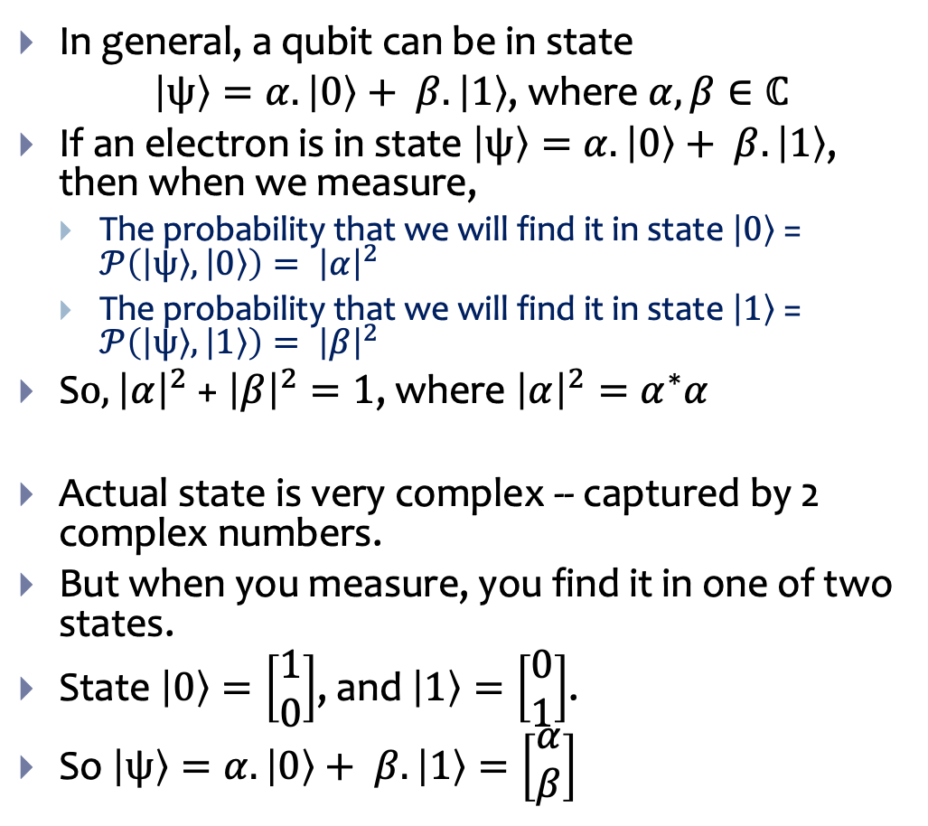
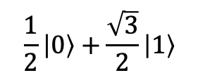

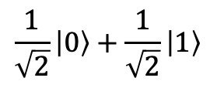
Superposition
In general, a qubit can be in state
$\left|ψ\right\rangle =α.\left|0\right\rangle + β.\left|1\right\rangle$, where $α, β∈ℂ$
If an electron is in state $\left|ψ\right\rangle =α.\left|0\right\rangle + β.\left|1\right\rangle$, then when we measure,
The probability that we will find it in state $\left|0\right\rangle$ = $𝒫\left(\left|ψ\right\rangle ,\left|0\right\rangle \right)= {\left|α\right|}^{2}$
The probability that we will find it in state $\left|1\right\rangle$ = $𝒫\left(\left|ψ\right\rangle ,\left|1\right\rangle \right)= {\left|β\right|}^{2}$
S$o, {\left|α\right|}^{2}$ + ${\left|β\right|}^{2}=1$, where ${\left|α\right|}^{2}=α^{∗}α$
Actual state is very complex -- captured by 2 complex numbers.
But when you measure, you find it in one of two states.
State $\left|0\right\rangle =\left[\begin{matrix}1 \\ 0\end{matrix}\right]$, and $\left|1\right\rangle =\left[\begin{matrix}0 \\ 1\end{matrix}\right]$.
So $\left|ψ\right\rangle =α.\left|0\right\rangle + β.\left|1\right\rangle =\left[\begin{matrix}α \\ β\end{matrix}\right]$
$$\frac{1}{2}\left|0\right\rangle +\frac{\sqrt{3}}{2}\left|1\right\rangle$$
$$\left|1\right\rangle$$
$$\frac{1}{\sqrt{2}}\left|0\right\rangle +\frac{1}{\sqrt{2}}\left|1\right\rangle$$
$$\left|0\right\rangle$$

Slide 4
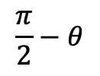

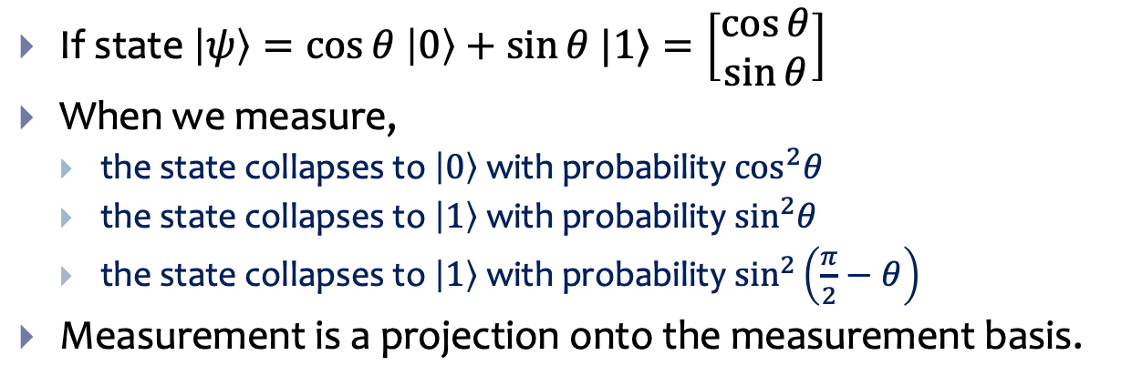








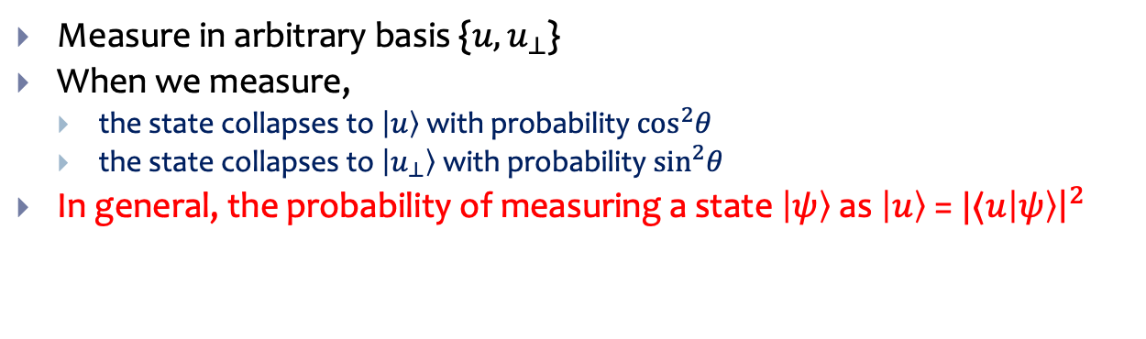

Measurement
$$\left|1\right\rangle$$
If state $\left|ψ\right\rangle =\cos{θ \left|0\right\rangle +\sin{θ |1⟩}}=\left[\begin{matrix}\cos{θ} \\ \sin{θ}\end{matrix}\right]$
When we measure,
the state collapses to $\left|0\right\rangle$ with probability $\cos^{2}θ$
the state collapses to $\left|1\right\rangle$ with probability $\sin^{2}θ$
the state collapses to $\left|1\right\rangle$ with probability $\sin^{2}\left(\frac{π}{2}−θ\right)$
Measurement is a projection onto the measurement basis.
$$\left|ψ\right\rangle$$
$$\frac{π}{2}−θ$$
$$θ$$
$$\left|0\right\rangle$$
$$\left|1\right\rangle$$
When you measure the state it gets projected onto one of the two basis states -- with probability equal to the cosine squared the angle it makes with the state.
$$\left|ψ\right\rangle$$
$$\left|u_{⊥}\right\rangle$$
Measure in arbitrary basis {$u, u_{⊥}$}
When we measure,
the state collapses to $\left|u\right\rangle$ with probability $\cos^{2}θ$
the state collapses to $\left|u_{⊥}\right\rangle$ with probability $\sin^{2}θ$
In general, the probability of measuring a state $\left|ψ\right\rangle$ as $\left|u\right\rangle$ = $|⟨u\left|ψ\right\rangle {\left.​\right|}^{2}$
$$\left|u\right\rangle$$
$$θ$$
$$\left|0\right\rangle$$

Slide 5
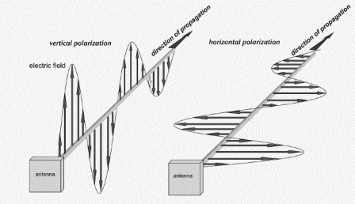

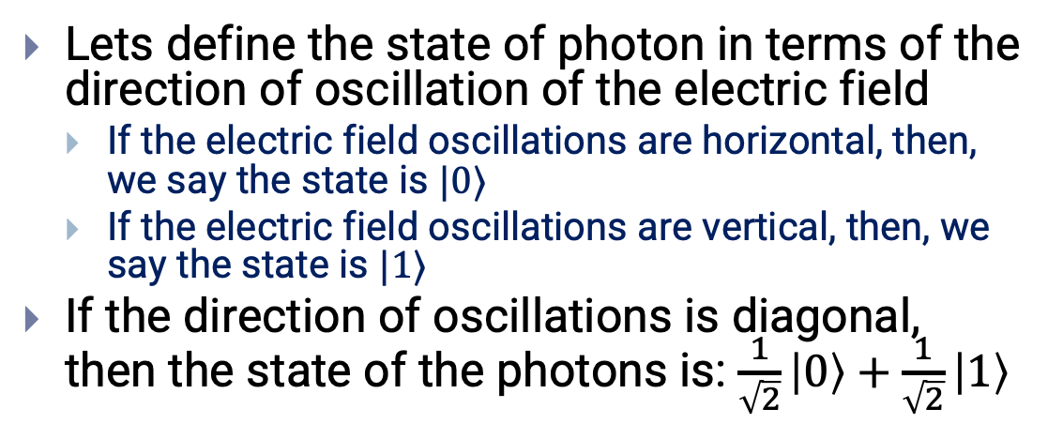



Example Light Polarization Experiment
Lets define the state of photon in terms of the direction of oscillation of the electric field
If the electric field oscillations are horizontal, then, we say the state is $|0⟩$
If the electric field oscillations are vertical, then, we say the state is $|1⟩$
If the direction of oscillations is diagonal, then the state of the photons is: $\frac{1}{\sqrt{2}}\left|0\right\rangle +\frac{1}{\sqrt{2}}\left|1\right\rangle$
$\left|ψ\right\rangle$ = $\frac{1}{\sqrt{2}}\left|0\right\rangle +\frac{1}{\sqrt{2}}\left|1\right\rangle$
$$\left|1\right\rangle =\left|↑\right\rangle$$
$$\left|0\right\rangle =\left|→\right\rangle$$
A horizontally polarized filter
A vertically polarized filter
A $45°$polarizing filter

Slide 6




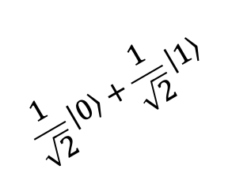
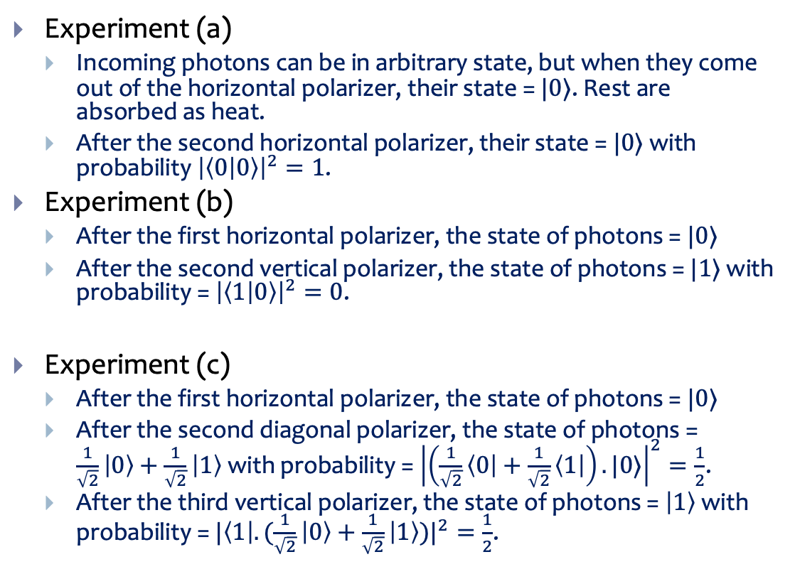








Light Polarization Experiment
(a)
$$100$$
$$100$$
Experiment (a)
Incoming photons can be in arbitrary state, but when they come out of the horizontal polarizer, their state = $|0⟩$. Rest are absorbed as heat.
After the second horizontal polarizer, their state = $|0⟩$ with probability ${\left|\left\langle 0 | 0\right\rangle \right|}^{2}=1$.
Experiment (b)
After the first horizontal polarizer, the state of photons = $|0⟩$
After the second vertical polarizer, the state of photons = $|1⟩$ with probability = ${\left|\left\langle 1 | 0\right\rangle \right|}^{2}=0$.
Experiment (c)
After the first horizontal polarizer, the state of photons = $|0⟩$
After the second diagonal polarizer, the state of photons = $\frac{1}{\sqrt{2}}\left|0\right\rangle +\frac{1}{\sqrt{2}}\left|1\right\rangle$with probability = ${\left|\left(\frac{1}{\sqrt{2}}\left\langle 0\right|+\frac{1}{\sqrt{2}}\left\langle 1\right|\right).|0⟩\right|}^{2}=\frac{1}{2}$.
After the third vertical polarizer, the state of photons = $\left|1\right\rangle$with probability = ${|\left\langle 1\right|.(\frac{1}{\sqrt{2}}\left|0\right\rangle +\frac{1}{\sqrt{2}}\left|1\right\rangle )|}^{2}=\frac{1}{2}$.
$$|0⟩$$
$$|0⟩$$
(b)
$$100$$
$$0$$
$$|0⟩$$
$$|1⟩$$
(c)
$$100$$
$$50$$
$$25$$
$$|0⟩$$
$$|1⟩$$
$$\frac{1}{\sqrt{2}}\left|0\right\rangle +\frac{1}{\sqrt{2}}\left|1\right\rangle$$

Slide 7



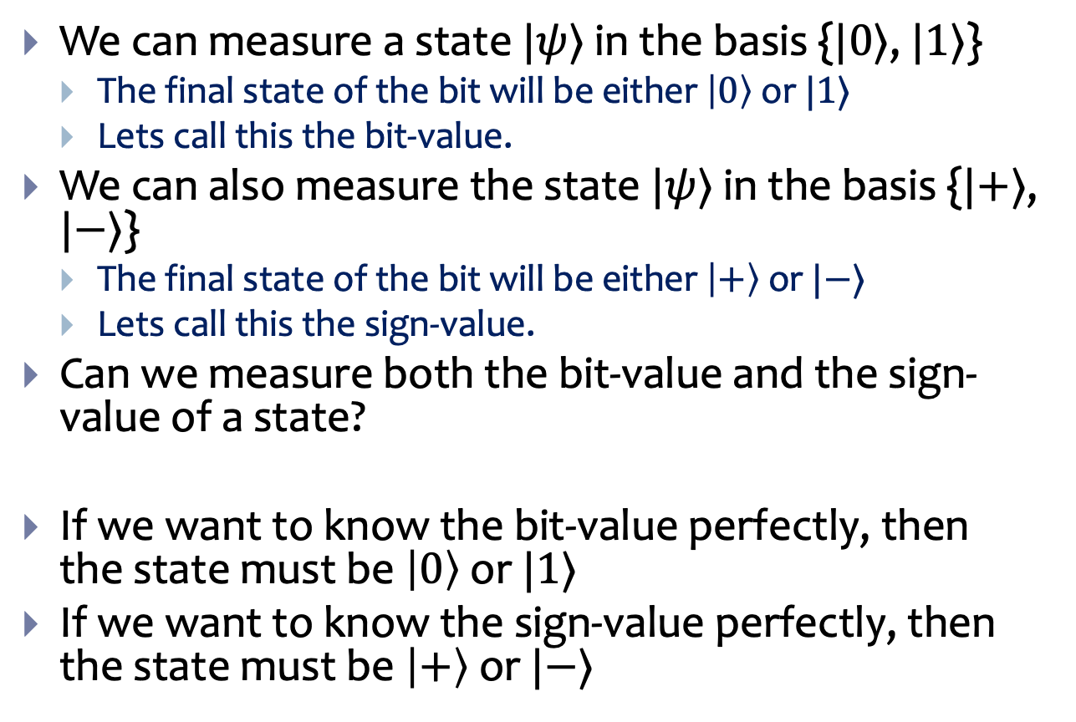
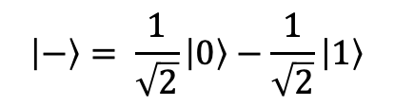

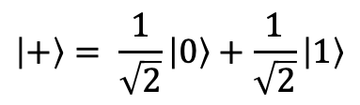
Uncertainty Principle
$$\left|1\right\rangle$$
$$\left|+\right\rangle = \frac{1}{\sqrt{2}}\left|0\right\rangle +\frac{1}{\sqrt{2}}\left|1\right\rangle$$
We can measure a state $|ψ⟩$ in the basis {$|0⟩$, $|1⟩$}
The final state of the bit will be either $\left|0\right\rangle$ or $|1⟩$
Lets call this the bit-value.
We can also measure the state $|ψ⟩$ in the basis {$|+⟩$, $|−⟩$}
The final state of the bit will be either $\left|+\right\rangle$ or $|−⟩$
Lets call this the sign-value.
Can we measure both the bit-value and the sign-value of a state?
If we want to know the bit-value perfectly, then the state must be $\left|0\right\rangle$ or $|1⟩$
If we want to know the sign-value perfectly, then the state must be $\left|+\right\rangle$ or $|−⟩$
$$\frac{π}{4}$$
$$\left|ψ\right\rangle$$
$$\left|0\right\rangle$$
$$\left|−\right\rangle = \frac{1}{\sqrt{2}}\left|0\right\rangle −\frac{1}{\sqrt{2}}\left|1\right\rangle$$

Slide 8


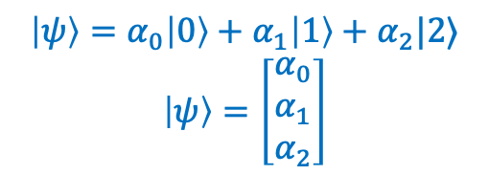
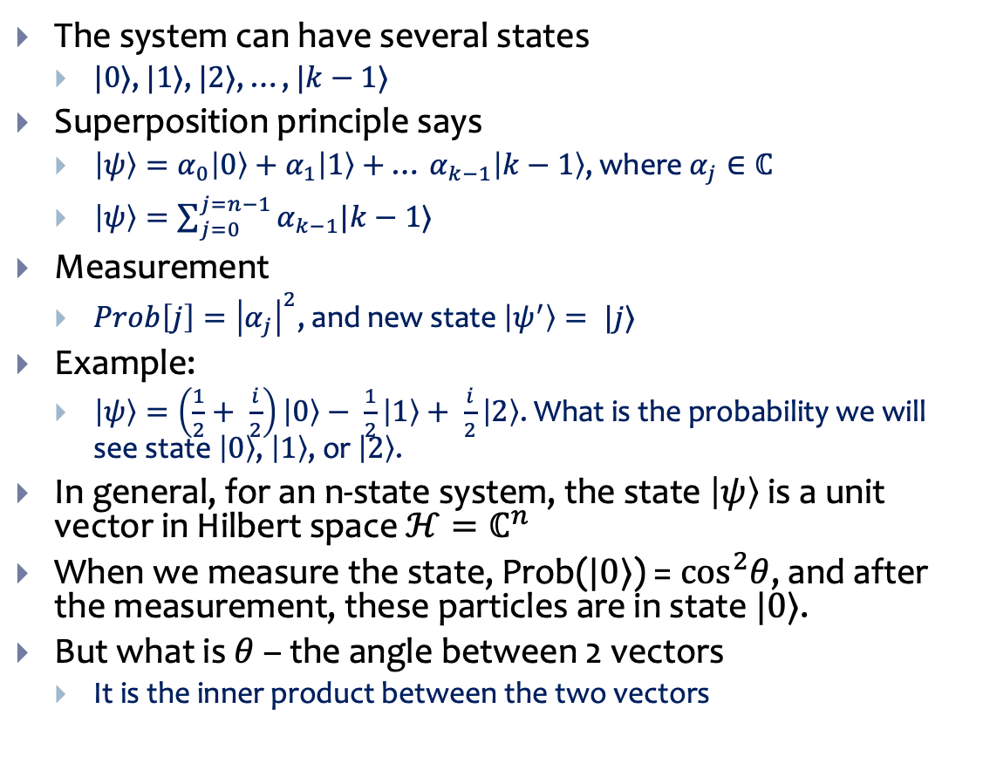



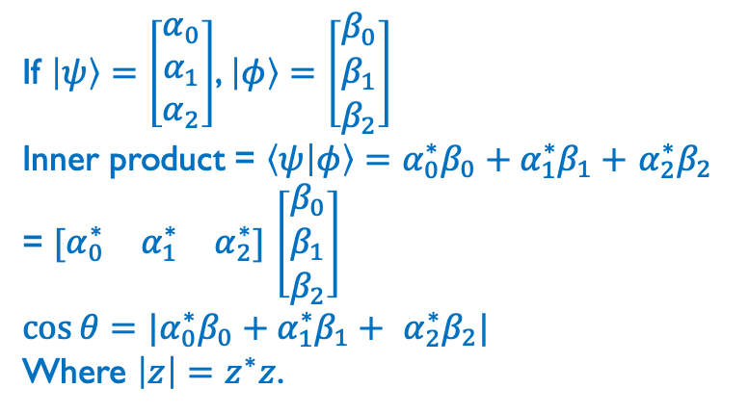
K-level system
$$\left|1\right\rangle$$
$$\left|2\right\rangle$$
The system can have several states
$|0⟩$, $|1⟩$, $|2⟩$, …, $|k−1⟩$
Superposition principle says
$\left|ψ\right\rangle =α_{0}\left|0\right\rangle +α_{1}\left|1\right\rangle +$ … $α_{k−1}\left|k−1\right\rangle$, where $α_{j}∈ℂ$
$\left|ψ\right\rangle =\sum_{j=0}^{j=n−1}{α_{k−1}|k−1⟩}$
Measurement
$Prob\left[j\right]={\left|α_{j}\right|}^{2}$, and new state $\left|ψ^{′}\right\rangle = |j⟩$
Example:
$\left|ψ\right\rangle =\left(\frac{1}{2}+ \frac{i}{2}\right)\left|0\right\rangle − \frac{1}{2}\left|1\right\rangle + \frac{i}{2}\left|2\right\rangle$. What is the probability we will see state $\left|0\right\rangle$, $\left|1\right\rangle$, or $\left|2\right\rangle$.
In general, for an n-state system, the state $\left|ψ\right\rangle$ is a unit vector in Hilbert space $ℋ=ℂ^{n}$
When we measure the state, Prob($|0⟩$) = $\cos^{2}θ$, and after the measurement, these particles are in state $|0⟩$.
But what is $θ$ – the angle between 2 vectors
It is the inner product between the two vectors
$$\left|ψ\right\rangle =α_{0}\left|0\right\rangle +α_{1}\left|1\right\rangle +α_{2}|2⟩$$
$$\left|ψ\right\rangle =\left[\begin{matrix}α_{0} \\ α_{1} \\ α_{2}\end{matrix}\right]$$
$$\left|ψ\right\rangle$$
$$θ$$
$$\left|0\right\rangle$$
If $\left|ψ\right\rangle =\left[\begin{matrix}α_{0} \\ α_{1} \\ α_{2}\end{matrix}\right]$, $\left|φ\right\rangle =\left[\begin{matrix}β_{0} \\ β_{1} \\ β_{2}\end{matrix}\right]$
Inner product = $\left\langle ψ | φ\right\rangle =α_{0}^{∗}β_{0}+α_{1}^{∗}β_{1}+$ $α_{2}^{∗}β_{2}$
= $[\begin{matrix}α_{0}^{∗} & α_{1}^{∗} & α_{2}^{∗}\end{matrix}]$ $\left[\begin{matrix}β_{0} \\ β_{1} \\ β_{2}\end{matrix}\right]$
$$\cos{θ=|α_{0}^{∗}β_{0}+α_{1}^{∗}β_{1}+ α_{2}^{∗}β_{2}|}$$
Where $\left|z\right|=z^{∗}z$.

Slide 9
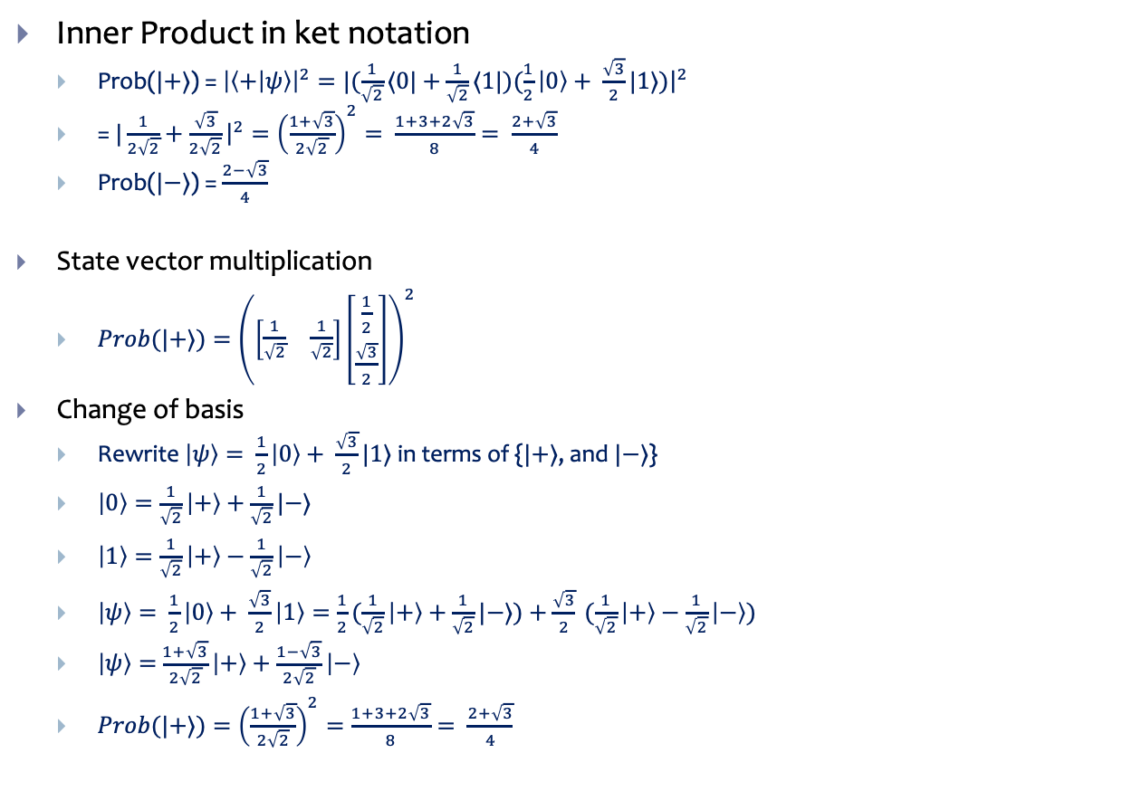



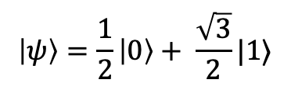
Measure $|ψ⟩$ in the sign basis, {$\left|+\right\rangle , |−⟩$}
$$\left|1\right\rangle$$
$$\left|ψ\right\rangle =\frac{1}{2}\left|0\right\rangle + \frac{\sqrt{3}}{2}|1⟩$$
Inner Product in ket notation
Prob($|+⟩$) = ${\left|\left\langle + | ψ\right\rangle \right|}^{2}=|{(\frac{1}{\sqrt{2}}⟨0|+\frac{1}{\sqrt{2}}⟨1|)(\frac{1}{2}\left|0\right\rangle + \frac{\sqrt{3}}{2}|1⟩)\left.​\right|}^{2}$
= $|{\frac{1}{2\sqrt{2}}+\frac{\sqrt{3}}{2\sqrt{2}}\left.​\right|}^{2}={\left(\frac{1+\sqrt{3}}{2\sqrt{2}}\right)}^{2}= \frac{1+3+2\sqrt{3}}{8}= \frac{2+\sqrt{3}}{4}$
Prob($|−⟩$) = $\frac{2−\sqrt{3}}{4}$
State vector multiplication
$Prob(|+⟩)={\left(\left[\begin{matrix}\frac{1}{\sqrt{2}} & \frac{1}{\sqrt{2}}\end{matrix}\right]\left[\begin{matrix}\frac{1}{2} \\ \frac{\sqrt{3}}{2}\end{matrix}\right]\right)}^{2}$
Change of basis
Rewrite $\left|ψ\right\rangle = \frac{1}{2}\left|0\right\rangle + \frac{\sqrt{3}}{2}|1⟩$ in terms of {$|+⟩$, and $|−⟩$}
$\left|0\right\rangle =\frac{1}{\sqrt{2}}\left|+\right\rangle +\frac{1}{\sqrt{2}}|−⟩$
$\left|1\right\rangle =\frac{1}{\sqrt{2}}\left|+\right\rangle −\frac{1}{\sqrt{2}}\left|−\right\rangle$
$\left|ψ\right\rangle = \frac{1}{2}\left|0\right\rangle + \frac{\sqrt{3}}{2}\left|1\right\rangle =\frac{1}{2}(\frac{1}{\sqrt{2}}\left|+\right\rangle +\frac{1}{\sqrt{2}}|−⟩)+\frac{\sqrt{3}}{2} (\frac{1}{\sqrt{2}}\left|+\right\rangle −\frac{1}{\sqrt{2}}\left|−\right\rangle )$
$\left|ψ\right\rangle =$ $\frac{1+\sqrt{3}}{2\sqrt{2}}\left|+\right\rangle +\frac{1−\sqrt{3}}{2\sqrt{2}}\left|−\right\rangle$
$Prob(|+⟩)={\left(\frac{1+\sqrt{3}}{2\sqrt{2}}\right)}^{2}=\frac{1+3+2\sqrt{3}}{8}= \frac{2+\sqrt{3}}{4}$
$$\left|+\right\rangle = \frac{1}{\sqrt{2}}\left|0\right\rangle +\frac{1}{\sqrt{2}}\left|1\right\rangle$$
$$\frac{π}{4}$$
$$\left|0\right\rangle$$
$$\left|−\right\rangle = \frac{1}{\sqrt{2}}\left|0\right\rangle −\frac{1}{\sqrt{2}}\left|1\right\rangle$$

Slide 10
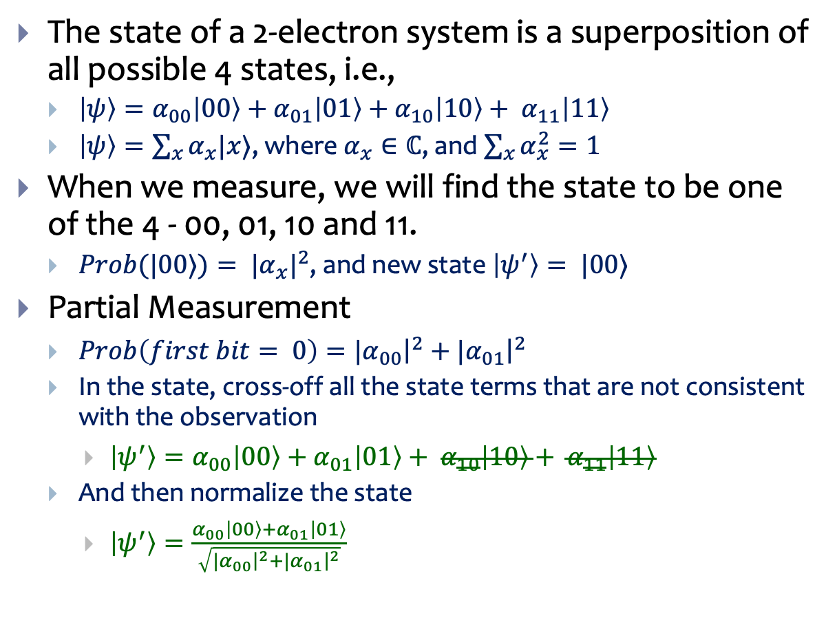
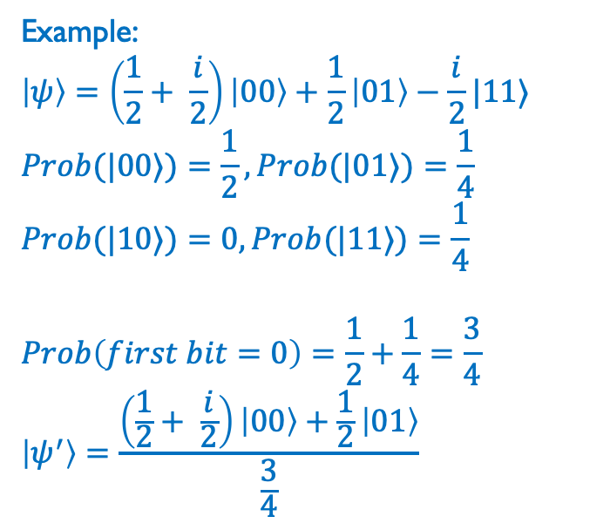
Two Qubit Systems
$$\left|1\right\rangle$$
$$\left|1\right\rangle$$
$$\left|0\right\rangle$$
$$\left|0\right\rangle$$
The state of a 2-electron system is a superposition of all possible 4 states, i.e.,
$\left|ψ\right\rangle =α_{00}\left|00\right\rangle +α_{01}\left|01\right\rangle +$ $α_{10}\left|10\right\rangle + α_{11}\left|11\right\rangle$
$\left|ψ\right\rangle =\sum_{x}{α_{x}|x⟩}$, where $α_{x}∈ℂ$, and $\sum_{x}{α_{x}^{2}=1}$
When we measure, we will find the state to be one of the 4 - 00, 01, 10 and 11.
$Prob(|00⟩)= {|α_{x}|}^{2}$, and new state $\left|ψ^{′}\right\rangle = |00⟩$
Partial Measurement
$Prob\left(first bit= 0\right)=|{\left.​α_{00}\right|}^{2}+|{\left.​α_{01}\right|}^{2}$
In the state, cross-off all the state terms that are not consistent with the observation
$\left|ψ^{′}\right\rangle =α_{00}\left|00\right\rangle +α_{01}\left|01\right\rangle + α_{10}\left|10\right\rangle + α_{11}\left|11\right\rangle$
And then normalize the state
$\left|ψ^{′}\right\rangle =\frac{α_{00}\left|00\right\rangle +α_{01}\left|01\right\rangle }{\sqrt{|{\left.​α_{00}\right|}^{2}+|{\left.​α_{01}\right|}^{2}}}$
Example:
$$\left|ψ\right\rangle =\left(\frac{1}{2}+ \frac{i}{2}\right)\left|00\right\rangle +\frac{1}{2}\left|01\right\rangle −\frac{i}{2}|11⟩$$
$$Prob(|00⟩)=\frac{1}{2}, Prob(|01⟩)=\frac{1}{4}$$
$$Prob(|10⟩)=0, Prob(|11⟩)=\frac{1}{4}$$
$$Prob\left(first bit=0\right)=\frac{1}{2}+\frac{1}{4}=\frac{3}{4}$$
$$\left|ψ^{′}\right\rangle =\frac{\left(\frac{1}{2}+ \frac{i}{2}\right)\left|00\right\rangle +\frac{1}{2}\left|01\right\rangle }{\frac{3}{4}}$$

Slide 11
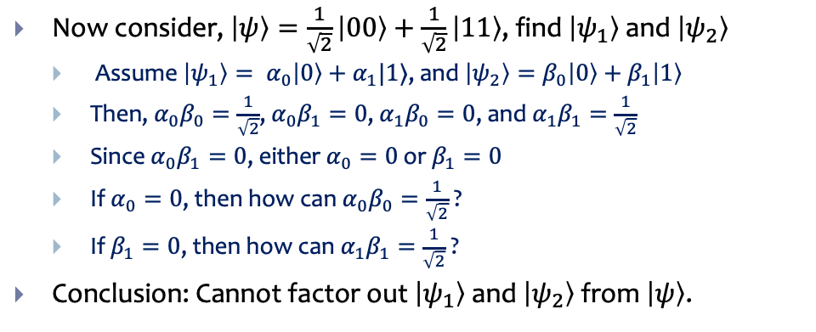

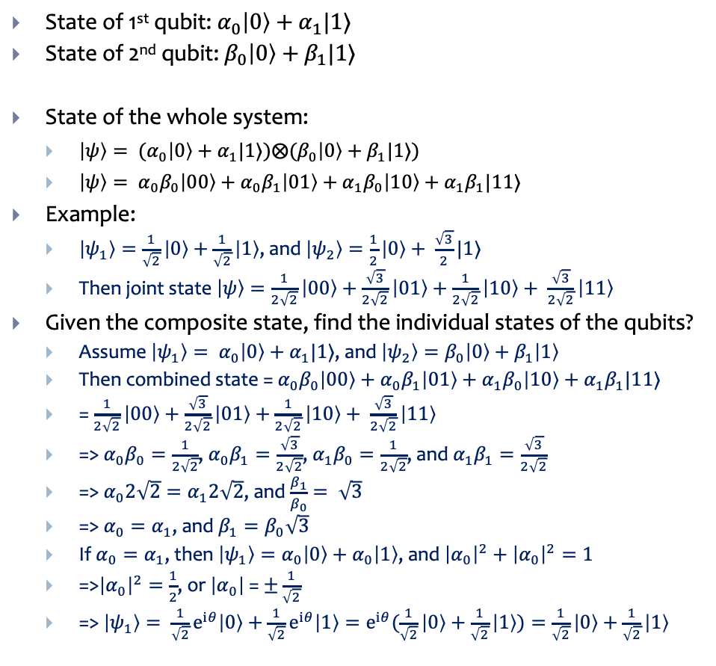

Entanglement
$$\left|1\right\rangle$$
$$\left|1\right\rangle$$
$$\left|0\right\rangle$$
$$\left|0\right\rangle$$
State of 1st qubit: $α_{0}\left|0\right\rangle +α_{1}|1⟩$
State of 2nd qubit: $β_{0}\left|0\right\rangle +β_{1}|1⟩$
State of the whole system:
$\left|ψ\right\rangle = (α_{0}\left|0\right\rangle +α_{1}|1⟩)⨂(β_{0}\left|0\right\rangle +β_{1}|1⟩)$
$\left|ψ\right\rangle = α_{0}β_{0}\left|00\right\rangle +α_{0}β_{1}\left|01\right\rangle +α_{1}β_{0}\left|10\right\rangle +α_{1}β_{1}|11⟩$
Example:
$\left|ψ_{1}\right\rangle =\frac{1}{\sqrt{2}}\left|0\right\rangle +\frac{1}{\sqrt{2}}\left|1\right\rangle$, and $\left|ψ_{2}\right\rangle =\frac{1}{2}\left|0\right\rangle + \frac{\sqrt{3}}{2}|1⟩$
Then joint state $\left|ψ\right\rangle =\frac{1}{2\sqrt{2}}\left|00\right\rangle +\frac{\sqrt{3}}{2\sqrt{2}}\left|01\right\rangle +$ $\frac{1}{2\sqrt{2}}\left|10\right\rangle + \frac{\sqrt{3}}{2\sqrt{2}}\left|11\right\rangle$
Given the composite state, find the individual states of the qubits?
Assume $\left|ψ_{1}\right\rangle = α_{0}\left|0\right\rangle +α_{1}|1⟩$, and $\left|ψ_{2}\right\rangle =β_{0}\left|0\right\rangle +β_{1}\left|1\right\rangle$
Then combined state = $α_{0}β_{0}\left|00\right\rangle +α_{0}β_{1}\left|01\right\rangle +α_{1}β_{0}\left|10\right\rangle +α_{1}β_{1}|11⟩$
= $\frac{1}{2\sqrt{2}}\left|00\right\rangle +\frac{\sqrt{3}}{2\sqrt{2}}\left|01\right\rangle +$ $\frac{1}{2\sqrt{2}}\left|10\right\rangle + \frac{\sqrt{3}}{2\sqrt{2}}\left|11\right\rangle$
=> $α_{0}β_{0}=\frac{1}{2\sqrt{2}}$, $α_{0}β_{1}=\frac{\sqrt{3}}{2\sqrt{2}}$, $α_{1}β_{0}=\frac{1}{2\sqrt{2}}$, and $α_{1}β_{1}=\frac{\sqrt{3}}{2\sqrt{2}}$
=> $α_{0}2\sqrt{2}=α_{1}2\sqrt{2}$, and $\frac{β_{1}}{β_{0}}= \sqrt{3}$
=> $α_{0}=α_{1}$, and $β_{1}=β_{0}\sqrt{3}$
If $α_{0}=α_{1}$, then $\left|ψ_{1}\right\rangle =α_{0}\left|0\right\rangle +α_{0}\left|1\right\rangle$, and ${\left|α_{0}\right|}^{2}+{\left|α_{0}\right|}^{2}=1$
=>${\left|α_{0}\right|}^{2}=\frac{1}{2}$, or $\left|α_{0}\right|$ = $±\frac{1}{\sqrt{2}}$
=> $\left|ψ_{1}\right\rangle = \frac{1}{\sqrt{2}}e^{iθ}\left|0\right\rangle +\frac{1}{\sqrt{2}}e^{iθ}\left|1\right\rangle =e^{iθ}(\frac{1}{\sqrt{2}}\left|0\right\rangle +\frac{1}{\sqrt{2}}\left|1\right\rangle )=\frac{1}{\sqrt{2}}\left|0\right\rangle +\frac{1}{\sqrt{2}}\left|1\right\rangle$
$$α_{0}\left|0\right\rangle +α_{1}|1⟩$$
$$β_{0}\left|0\right\rangle +β_{1}|1⟩$$
Now consider, $\left|ψ\right\rangle =\frac{1}{\sqrt{2}}\left|00\right\rangle +\frac{1}{\sqrt{2}}\left|11\right\rangle$, find $\left|ψ_{1}\right\rangle$ and $\left|ψ_{2}\right\rangle$
Assume $\left|ψ_{1}\right\rangle = α_{0}\left|0\right\rangle +α_{1}|1⟩$, and $\left|ψ_{2}\right\rangle =β_{0}\left|0\right\rangle +β_{1}\left|1\right\rangle$
Then, $α_{0}β_{0}=\frac{1}{\sqrt{2}}$, $α_{0}β_{1}=0$, $α_{1}β_{0}=0$, and $α_{1}β_{1}=\frac{1}{\sqrt{2}}$
Since $α_{0}β_{1}=0$, either $α_{0}=0$ or $β_{1}=0$
If $α_{0}=0$, then how can $α_{0}β_{0}=\frac{1}{\sqrt{2}}$ ?
If $β_{1}=0$, then how can $α_{1}β_{1}=\frac{1}{\sqrt{2}}$ ?
Conclusion: Cannot factor out $\left|ψ_{1}\right\rangle$ and $\left|ψ_{2}\right\rangle$ from $\left|ψ\right\rangle$.

Slide 12
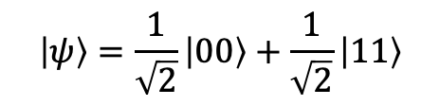
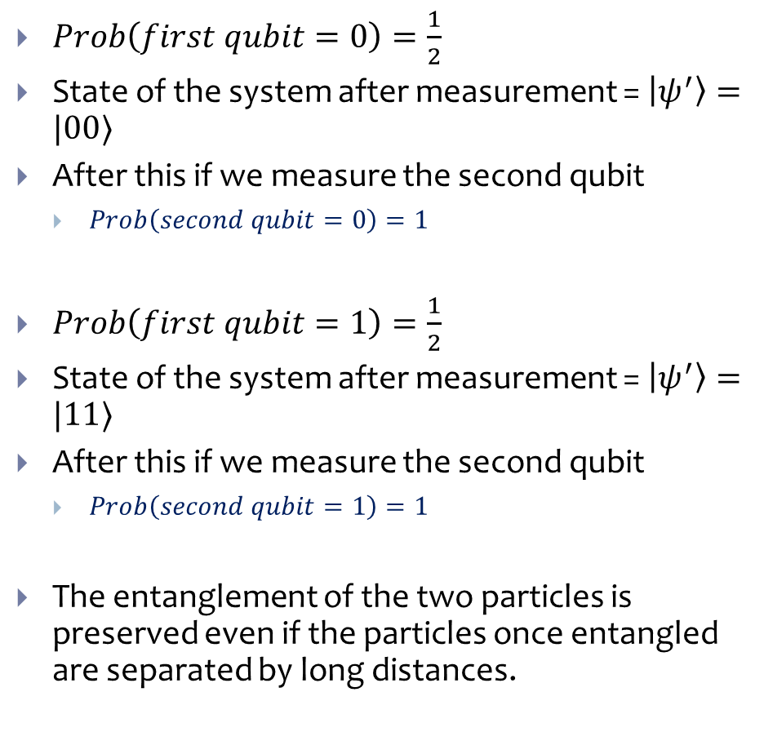
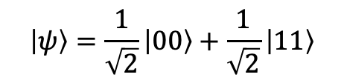
Measuring the Bell state
$$\left|1\right\rangle$$
$$\left|1\right\rangle$$
$$\left|0\right\rangle$$
$$\left|0\right\rangle$$
$Prob\left(first qubit=0\right)=\frac{1}{2}$
State of the system after measurement = $\left|ψ^{′}\right\rangle =|00⟩$
After this if we measure the second qubit
$Prob\left(second qubit=0\right)=1$
$Prob\left(first qubit=1\right)=\frac{1}{2}$
State of the system after measurement = $\left|ψ^{′}\right\rangle =|11⟩$
After this if we measure the second qubit
$Prob\left(second qubit=1\right)=1$
The entanglement of the two particles is preserved even if the particles once entangled are separated by long distances.
$$\left|ψ\right\rangle =\frac{1}{\sqrt{2}}\left|00\right\rangle +\frac{1}{\sqrt{2}}\left|11\right\rangle$$
$$\left|1\right\rangle$$
$$\left|1\right\rangle$$
$$\left|0\right\rangle$$
$$\left|0\right\rangle$$
$$\left|ψ\right\rangle =\frac{1}{\sqrt{2}}\left|00\right\rangle +\frac{1}{\sqrt{2}}\left|11\right\rangle$$

Slide 13




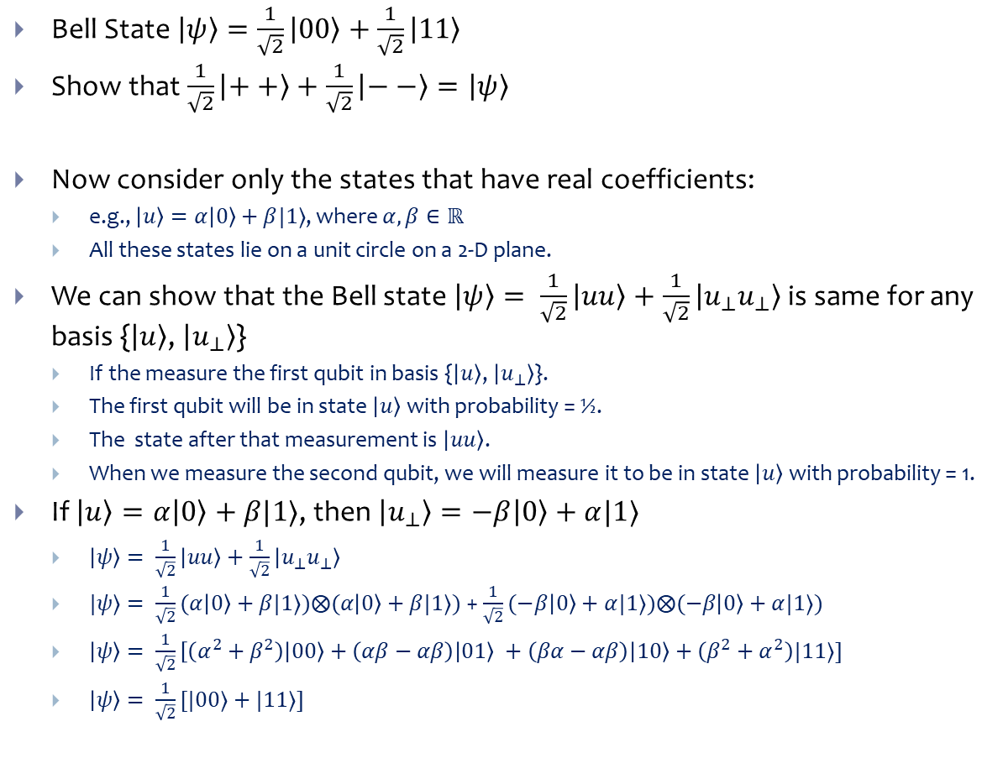






Rotational Invariance of the Bell State
Bell State $\left|ψ\right\rangle =\frac{1}{\sqrt{2}}\left|00\right\rangle +\frac{1}{\sqrt{2}}\left|11\right\rangle$
Show that $\frac{1}{\sqrt{2}}\left|++\right\rangle +\frac{1}{\sqrt{2}}\left|−−\right\rangle =\left|ψ\right\rangle$
Now consider only the states that have real coefficients:
e.g., $\left|u\right\rangle =α\left|0\right\rangle +β|1⟩$, where $α, β∈ℝ$
All these states lie on a unit circle on a 2-D plane.
We can show that the Bell state $\left|ψ\right\rangle = \frac{1}{\sqrt{2}}\left|uu\right\rangle +\frac{1}{\sqrt{2}}\left|u_{⊥}u_{⊥}\right\rangle$ is same for any basis {$\left|u\right\rangle$, $\left|u_{⊥}\right\rangle$}
If the measure the first qubit in basis {$\left|u\right\rangle$, $\left|u_{⊥}\right\rangle$}.
The first qubit will be in state $\left|u\right\rangle$ with probability = ½.
The state after that measurement is $\left|uu\right\rangle$.
When we measure the second qubit, we will measure it to be in state $\left|u\right\rangle$ with probability = 1.
If $\left|u\right\rangle =α\left|0\right\rangle +β|1⟩$, then $\left|u_{⊥}\right\rangle =−β\left|0\right\rangle +α|1⟩$
$\left|ψ\right\rangle = \frac{1}{\sqrt{2}}\left|uu\right\rangle +\frac{1}{\sqrt{2}}\left|u_{⊥}u_{⊥}\right\rangle$
$|ψ⟩= \frac{1}{\sqrt{2}}(α\left|0\right\rangle +β|1⟩)⨂(α\left|0\right\rangle +β|1⟩)$ + $\frac{1}{\sqrt{2}}(−β\left|0\right\rangle +α|1⟩)⨂(−β\left|0\right\rangle +α|1⟩)$
$\left|ψ\right\rangle = \frac{1}{\sqrt{2}}\left[\left(α^{2}+β^{2}\right)\left|00\right\rangle +\left(αβ−αβ\right) | 01\right\rangle +\left(βα−αβ\right)\left|10\right\rangle +\left(β^{2}+α^{2}\right)|11⟩]$
$\left|ψ\right\rangle = \frac{1}{\sqrt{2}}[|00⟩+|11⟩]$
$$\left|1\right\rangle$$
$$\left|u_{⊥}\right\rangle$$
$$\left|u\right\rangle$$
$$\left|0\right\rangle$$
$$\left|1\right\rangle$$
$$α$$
$$β$$
$$β$$
$$α$$
$$\left|0\right\rangle$$

Slide 14




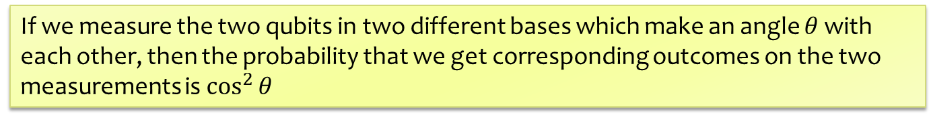




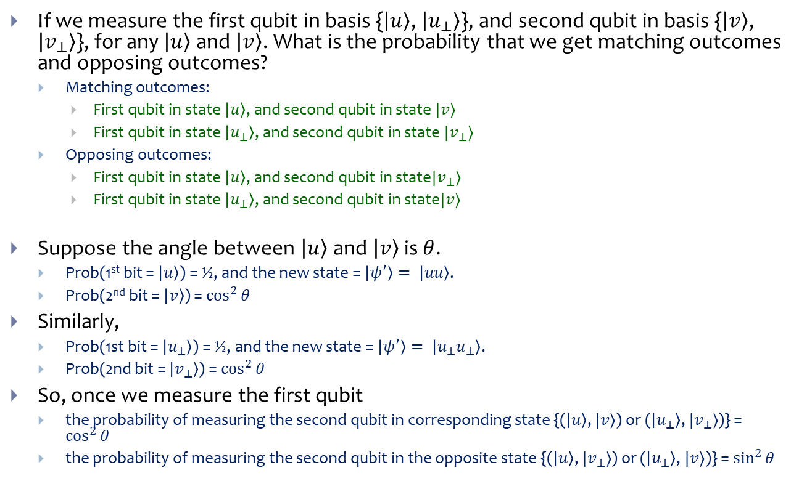
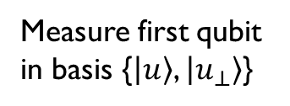




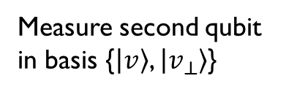








Rotational Invariance of the Bell State
$$\left|1\right\rangle$$
If we measure the first qubit in basis {$\left|u\right\rangle$, $\left|u_{⊥}\right\rangle$}, and second qubit in basis {$\left|v\right\rangle$, $\left|v_{⊥}\right\rangle$}, for any $\left|u\right\rangle$and $\left|v\right\rangle$. What is the probability that we get matching outcomes and opposing outcomes?
Matching outcomes:
First qubit in state $\left|u\right\rangle$, and second qubit in state $|v⟩$
First qubit in state $\left|u_{⊥}\right\rangle$, and second qubit in state $|v_{⊥}⟩$
Opposing outcomes:
First qubit in state $\left|u\right\rangle$, and second qubit in state$|v_{⊥}⟩$
First qubit in state $\left|u_{⊥}\right\rangle$, and second qubit in state$|v⟩$
Suppose the angle between $\left|u\right\rangle$and $\left|v\right\rangle$ is $θ$.
Prob(1st bit = $\left|u\right\rangle$) = ½, and the new state = $\left|ψ^{′}\right\rangle = \left|uu\right\rangle$.
Prob(2nd bit = $\left|v\right\rangle$) = $\cos^{2}{θ}$
Similarly,
Prob(1st bit = $\left|u_{⊥}\right\rangle$) = ½, and the new state = $\left|ψ^{′}\right\rangle = \left|u_{⊥}u_{⊥}\right\rangle$.
Prob(2nd bit = $\left|v_{⊥}\right\rangle$) = $\cos^{2}{θ}$
So, once we measure the first qubit
the probability of measuring the second qubit in corresponding state {($\left|u\right\rangle$, $|v⟩$) or ($\left|u_{⊥}\right\rangle$, $|v_{⊥}⟩$)} = $\cos^{2}{θ}$
the probability of measuring the second qubit in the opposite state {($\left|u\right\rangle$, $|v_{⊥}⟩$) or ($\left|u_{⊥}\right\rangle$, $|v⟩$)} = $\sin^{2}{θ}$
$$β$$
$$α$$
$$\left|0\right\rangle$$
$$\left|1\right\rangle$$
$$\left|1\right\rangle$$
$$\left|u_{⊥}\right\rangle$$
$$\left|v_{⊥}\right\rangle$$
$$\left|v\right\rangle$$
$$\left|u\right\rangle$$
$$\left|0\right\rangle$$
$$\left|0\right\rangle$$
Measure first qubit in basis {$\left|u\right\rangle$, $\left|u_{⊥}\right\rangle$}
Measure second qubit in basis {$\left|v\right\rangle$, $\left|v_{⊥}\right\rangle$}
$$\left|1\right\rangle$$
$$\left|u_{⊥}\right\rangle$$
$$\left|v_{⊥}\right\rangle$$
$$\left|v\right\rangle$$
$$θ$$
$$θ$$
$$\left|u\right\rangle$$
$$\left|0\right\rangle$$
If we measure the two qubits in two different bases which make an angle $θ$ with each other, then the probability that we get corresponding outcomes on the two measurements is $\cos^{2}{θ}$

Slide 15



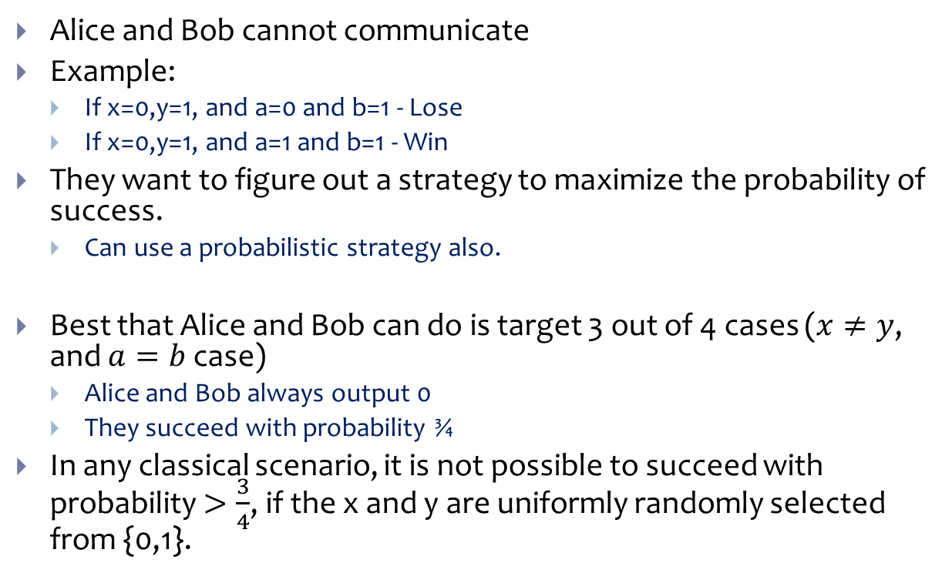
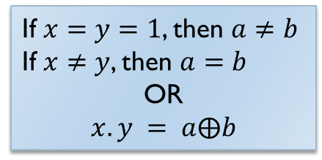



CHSH Inequality - Classical
Clauser, Horn, Shimony, and Holt (CHSH) Inequality
Alice
Bob
Alice and Bob cannot communicate
Example:
If x=0,y=1, and a=0 and b=1 - Lose
If x=0,y=1, and a=1 and b=1 - Win
They want to figure out a strategy to maximize the probability of success.
Can use a probabilistic strategy also.
Best that Alice and Bob can do is target 3 out of 4 cases ($x≠y$, and $a=b$ case)
Alice and Bob always output 0
They succeed with probability ¾
In any classical scenario, it is not possible to succeed with probability $>\frac{3}{4}$, if the x and y are uniformly randomly selected from {0,1}.
Input
$$x∈\{0,1\}$$
$$y∈\{0,1\}$$
Output
$$a∈\{0,1\}$$
$$b∈\{0,1\}$$
If $x=y=1$, then $a≠b$
If $x≠y$, then $a=b$
OR
$$x.y = a⨁b$$

Slide 16



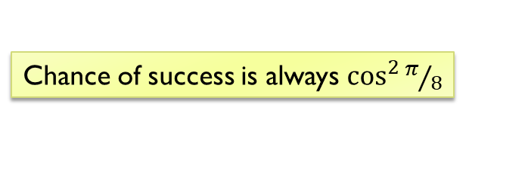
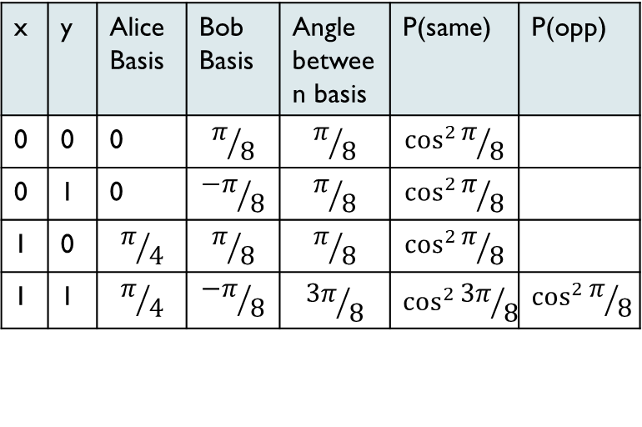


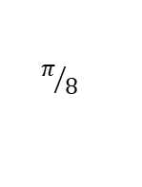

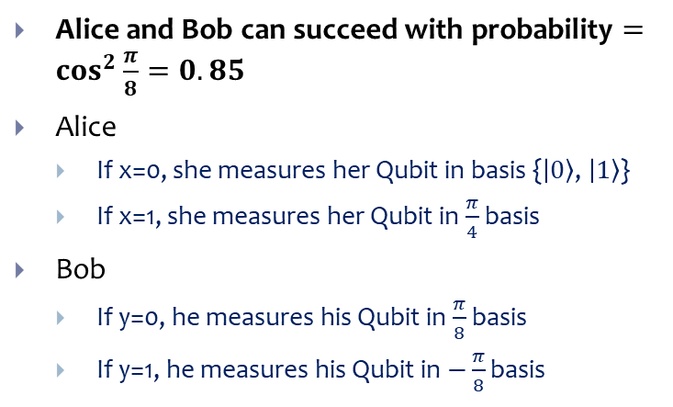

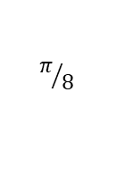
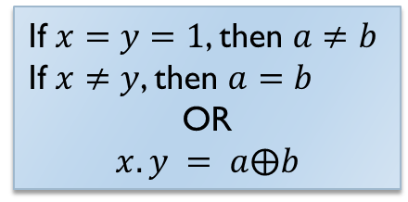




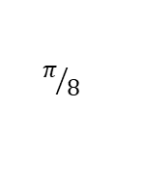

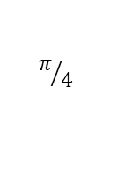

CHSH Inequality – With an entangled pair
$$\left|1\right\rangle$$
Alice and Bob can succeed with probability $=\cos^{2}{\frac{π}{8}=0.85}$
Alice
If x=0, she measures her Qubit in basis {$\left|0\right\rangle$, $\left|1\right\rangle$}
If x=1, she measures her Qubit in $\frac{π}{4}$ basis
Bob
If y=0, he measures his Qubit in $\frac{π}{8}$ basis
If y=1, he measures his Qubit in $−\frac{π}{8}$ basis
$$\left|0\right\rangle$$
$$π/4$$
Alice
Bob
$$\left|1\right\rangle$$
$$π/8$$
$$\left|0\right\rangle$$
Input
$$x∈\{0,1\}$$
$$y∈\{0,1\}$$
$$π/8$$
Output
$$a∈\{0,1\}$$
$$b∈\{0,1\}$$
$$\left|1\right\rangle$$
x | y | Alice Basis | Bob Basis | Angle between basis | P(same) | P(opp)
0 | 0 | 0 | $$π/8$$ | $$π/8$$ | $$\cos^{2}{π/8}$$
0 | 1 | 0 | $${−π}/8$$ | $$π/8$$ | $$\cos^{2}{π/8}$$
1 | 0 | $$π/4$$ | $$π/8$$ | $$π/8$$ | $$\cos^{2}{π/8}$$
1 | 1 | $$π/4$$ | $${−π}/8$$ | $${3π}/8$$ | $$\cos^{2}{{3π}/8}$$ | $$\cos^{2}{π/8}$$
$$x_{1}$$
If $x=y=1$, then $a≠b$
If $x≠y$, then $a=b$
OR
$$x.y = a⨁b$$
$$π/8$$
$$y_{0}$$
$$π/8$$
$$x_{0}$$
$$π/8$$
$$y_{1}$$
Chance of success is always $\cos^{2}{π/8}$

Slide 17





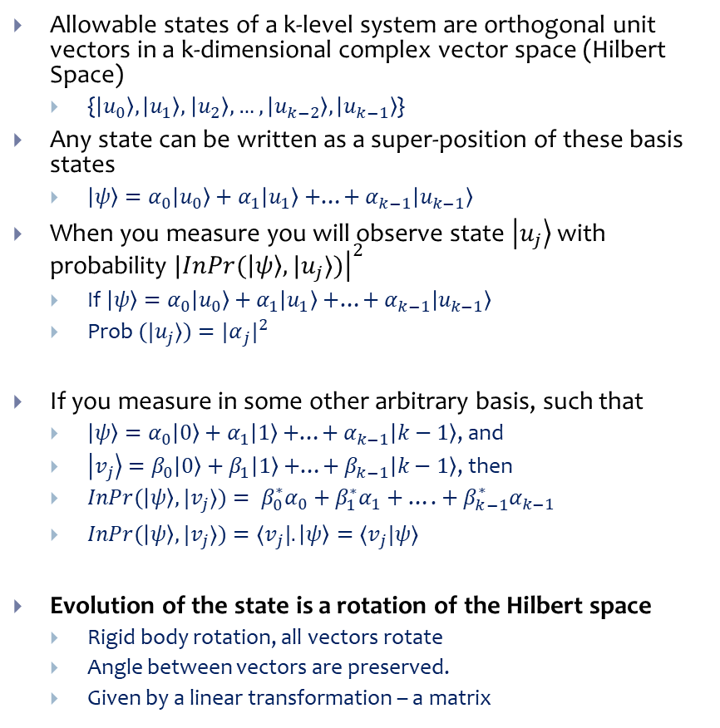







Evolution of a Quantum System
$$\left|u_{k−1}\right\rangle$$
$$\left|u_{2}\right\rangle$$
Allowable states of a k-level system are orthogonal unit vectors in a k-dimensional complex vector space (Hilbert Space)
{$\left|u_{0}\right\rangle ,\left|u_{1}\right\rangle ,$ $\left|u_{2}\right\rangle , …, \left|u_{k−2}\right\rangle , \left|u_{k−1}\right\rangle$}
Any state can be written as a super-position of these basis states
$\left|ψ\right\rangle =α_{0}\left|u_{0}\right\rangle +α_{1}\left|u_{1}\right\rangle +$…$+$ $α_{k−1}\left|u_{k−1}\right\rangle$
When you measure you will observe state $\left|u_{j}\right\rangle$ with probability $|{\left.​InPr(\left|ψ\right\rangle , |u_{j}⟩)\right|}^{2}$
If $\left|ψ\right\rangle =α_{0}\left|u_{0}\right\rangle +α_{1}\left|u_{1}\right\rangle +$…$+$ $α_{k−1}\left|u_{k−1}\right\rangle$
Prob $(|u_{j}⟩)={{|α}_{j}|}^{2}$
If you measure in some other arbitrary basis, such that
$\left|ψ\right\rangle =α_{0}\left|0\right\rangle +α_{1}\left|1\right\rangle +$…$+$ $α_{k−1}\left|k−1\right\rangle$, and
$\left|v_{j}\right\rangle =β_{0}\left|0\right\rangle +β_{1}\left|1\right\rangle +$…$+$ $β_{k−1}\left|k−1\right\rangle$, then
$InPr(\left|ψ\right\rangle , |v_{j}⟩)= β_{0}^{∗}α_{0}+$ $β_{1}^{∗}α_{1}+$ …. $+$ $β_{k−1}^{∗}α_{k−1}$
$InPr(\left|ψ\right\rangle , |v_{j}⟩)=⟨v_{j}|.\left|ψ\right\rangle =⟨v_{j}|ψ⟩$
Evolution of the state is a rotation of the Hilbert space
Rigid body rotation, all vectors rotate
Angle between vectors are preserved.
Given by a linear transformation – a matrix
$$\left|u_{1}\right\rangle$$
$$\left|u_{0}\right\rangle$$
$$\left|1\right\rangle$$
$$U\left|ψ\right\rangle$$
$$U\left|φ\right\rangle$$
$$\left|ψ\right\rangle$$
$$U\left|0\right\rangle$$
$$U\left|1\right\rangle$$
$$\left|φ\right\rangle$$
$$\left|0\right\rangle$$

Slide 18


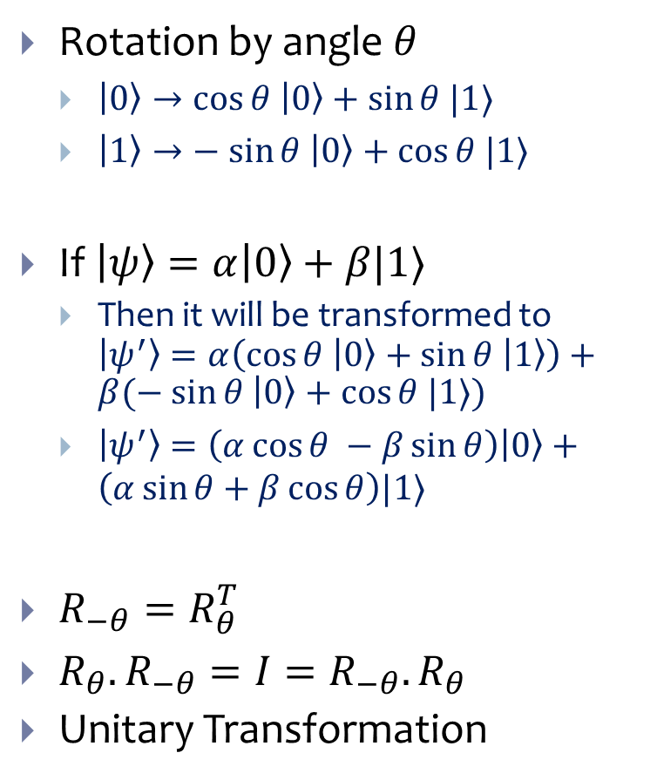



Evolution of a Quantum System
$$\left|1\right\rangle$$
Rotation by angle $θ$
$\left|0\right\rangle →\cos{θ \left|0\right\rangle +\sin{θ |1⟩}}$
$\left|1\right\rangle →− sin{θ \left|0\right\rangle +\cos{θ |1⟩}}$
If $\left|ψ\right\rangle =α\left|0\right\rangle +β|1⟩$
Then it will be transformed to $\left|ψ^{′}\right\rangle =α\left(\cos{θ \left|0\right\rangle +\sin{θ \left|1\right\rangle }}\right)+β(− sin{θ \left|0\right\rangle +\cos{θ |1⟩}})$
$\left|ψ^{′}\right\rangle =\left(α\cos{θ −β\sin{θ}}\right)\left|0\right\rangle +\left(α\sin{θ+β\cos{θ}}\right)|1⟩$
$R_{−θ}=R_{θ}^{T}$
$R_{θ}.R_{−θ}=I=R_{−θ}.R_{θ}$
Unitary Transformation
$$R_{θ}=\left[\begin{matrix}\cos{θ} & −\sin{θ} \\ \sin{θ} & \cos{θ}\end{matrix}\right]$$
$$θ$$
$$\left|0\right\rangle$$
$$R_{−θ}=\left[\begin{matrix}\cos{θ} & \sin{θ} \\ −\sin{θ} & \cos{θ}\end{matrix}\right]$$

Slide 19
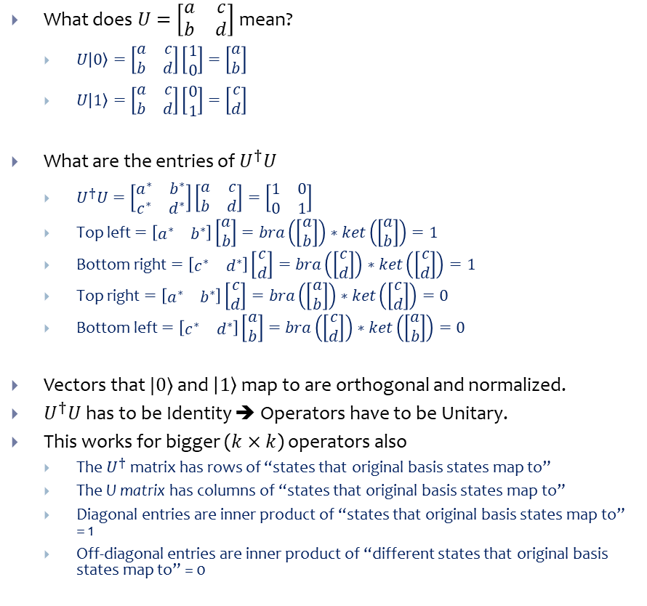
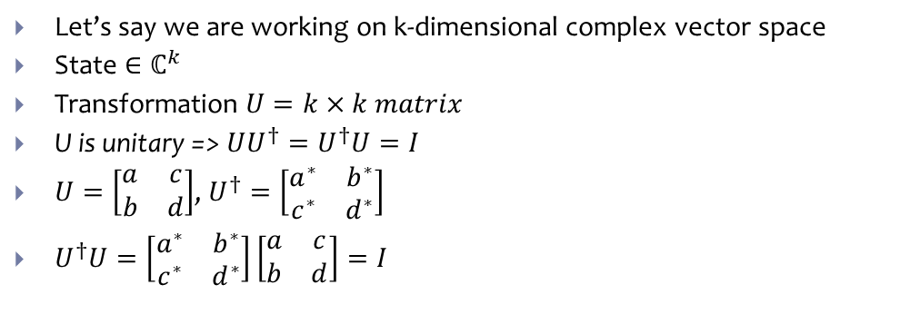
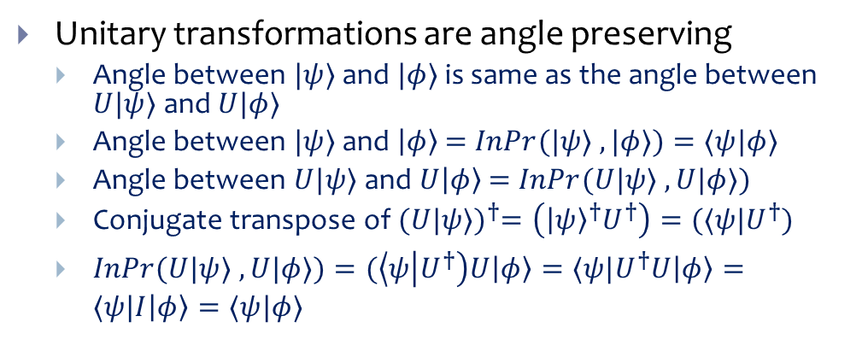
Unitary Transformations
What does $U=\left[\begin{matrix}a & c \\ b & d\end{matrix}\right]$ mean?
$U\left|0\right\rangle =\left[\begin{matrix}a & c \\ b & d\end{matrix}\right]\left[\begin{matrix}1 \\ 0\end{matrix}\right]=\left[\begin{matrix}a \\ b\end{matrix}\right]$
$U\left|1\right\rangle =\left[\begin{matrix}a & c \\ b & d\end{matrix}\right]\left[\begin{matrix}0 \\ 1\end{matrix}\right]=\left[\begin{matrix}c \\ d\end{matrix}\right]$
What are the entries of $U^{†}U$
$U^{†}U=\left[\begin{matrix}a^{∗} & b^{∗} \\ c^{∗} & d^{∗}\end{matrix}\right]\left[\begin{matrix}a & c \\ b & d\end{matrix}\right]=\left[\begin{matrix}1 & 0 \\ 0 & 1\end{matrix}\right]$
Top left $=\left[\begin{matrix}a^{∗} & b^{∗}\end{matrix}\right]\left[\begin{matrix}a \\ b\end{matrix}\right]=bra\left(\left[\begin{matrix}a \\ b\end{matrix}\right]\right)∗ket\left(\left[\begin{matrix}a \\ b\end{matrix}\right]\right)=1$
Bottom right $=\left[\begin{matrix}c^{∗} & d^{∗}\end{matrix}\right]\left[\begin{matrix}c \\ d\end{matrix}\right]=bra\left(\left[\begin{matrix}c \\ d\end{matrix}\right]\right)∗ket\left(\left[\begin{matrix}c \\ d\end{matrix}\right]\right)=1$
Top right $=\left[\begin{matrix}a^{∗} & b^{∗}\end{matrix}\right]\left[\begin{matrix}c \\ d\end{matrix}\right]=bra\left(\left[\begin{matrix}a \\ b\end{matrix}\right]\right)∗ket\left(\left[\begin{matrix}c \\ d\end{matrix}\right]\right)=0$
Bottom left $=\left[\begin{matrix}c^{∗} & d^{∗}\end{matrix}\right]\left[\begin{matrix}a \\ b\end{matrix}\right]=bra\left(\left[\begin{matrix}c \\ d\end{matrix}\right]\right)∗ket\left(\left[\begin{matrix}a \\ b\end{matrix}\right]\right)=0$
Vectors that $|0⟩$ and $\left|1\right\rangle$ map to are orthogonal and normalized.
$U^{†}U$ has to be Identity ➔ Operators have to be Unitary.
This works for bigger ($k×k$) operators also
The $U^{†}$ matrix has rows of “states that original basis states map to”
The U matrix has columns of “states that original basis states map to”
Diagonal entries are inner product of “states that original basis states map to” = 1
Off-diagonal entries are inner product of “different states that original basis states map to” = 0
Let’s say we are working on k-dimensional complex vector space
State $∈ℂ^{k}$
Transformation $U=k×k matrix$
U is unitary => $UU^{†}=U^{†}U=I$
$U=\left[\begin{matrix}a & c \\ b & d\end{matrix}\right]$, $U^{†}=\left[\begin{matrix}a^{∗} & b^{∗} \\ c^{∗} & d^{∗}\end{matrix}\right]$
$U^{†}U=\left[\begin{matrix}a^{∗} & b^{∗} \\ c^{∗} & d^{∗}\end{matrix}\right]\left[\begin{matrix}a & c \\ b & d\end{matrix}\right]=I$
Unitary transformations are angle preserving
Angle between $|ψ⟩$ and $|φ⟩$ is same as the angle between $U|ψ⟩$ and $U|φ⟩$
Angle between $|ψ⟩$ and $\left|φ\right\rangle$ = $InPr(|ψ⟩ , |φ⟩)=⟨ψ|φ⟩$
Angle between $U|ψ⟩$ and $U\left|φ\right\rangle$ = $InPr(U|ψ⟩ , U|φ⟩)$
Conjugate transpose of ${(U|ψ⟩)}^{†}=\left({\left|ψ\right\rangle }^{†}U^{†}\right)=(⟨ψ|U^{†})$
$InPr(U|ψ⟩ , U|φ⟩)=(\left\langle ψ | U^{†}\right)U\left|φ\right\rangle =⟨ψ|U^{†}U\left|φ\right\rangle =⟨ψ|I\left|φ\right\rangle =⟨ψ|φ⟩$

Slide 20
References
Quantum Computing – Vazirani, UCB
Quantum Computation – Zilin Jiang, ASU

